Slide 1
Lean4Math
Using Neural Methods To Improve Math Reasoning in LLMs
Michael S., Willy C., Jakob N.
Notes:
[]
Intro

Slide 2
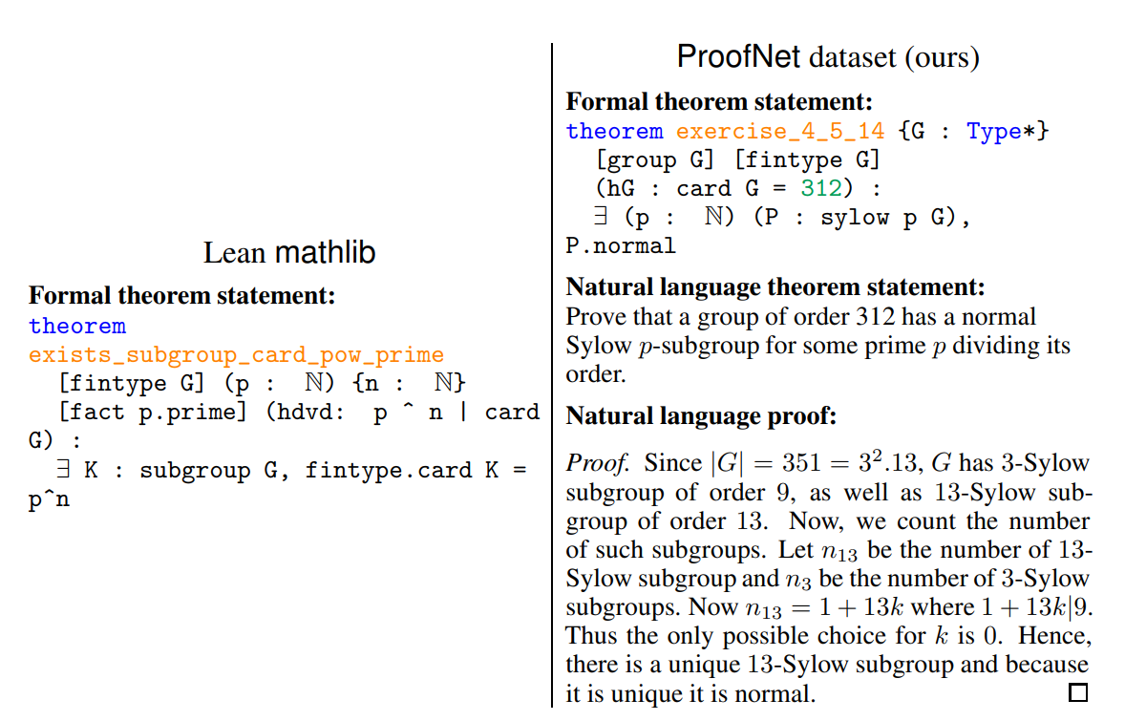
Problem
Performing automated theorem proving has been a longstanding goal of mathematics
Advent of LLMs presents novel approach of treating mathematical reasoning as a sequential learning task
Current LLMs are limited in mathematical reasoning abilities
Kunhao Zheng, Jesse Michael Han, and Stanislas Polu. Minif2f: a cross-system benchmark for formal olympiad-level mathematics. arXiv preprint arXiv:2109.00110, 2021
Notes:
[Michael]
Mathematicians have always wanted to explore automated theorem proving, and the advent of LLMs presents a new opportunity to explore this idea. This is made better by the abundance of natural language math data on the internet that we can use to train these models, but stock LLMs have very limited quantitative reasoning capabilities when understanding natural language proofs.
Recently, there’s been even more development on the availability formal proof data in the Lean programming language through datasets like MathLib 4, as well as parallel data between informal and formal mathematics such as those in the ProofNet.
So there’s a lot of data, and modern LLMs present a novel means of leveraging this data to perform autoformalization. However, current models are limited in their mathematical reasoning abilities.

Slide 3
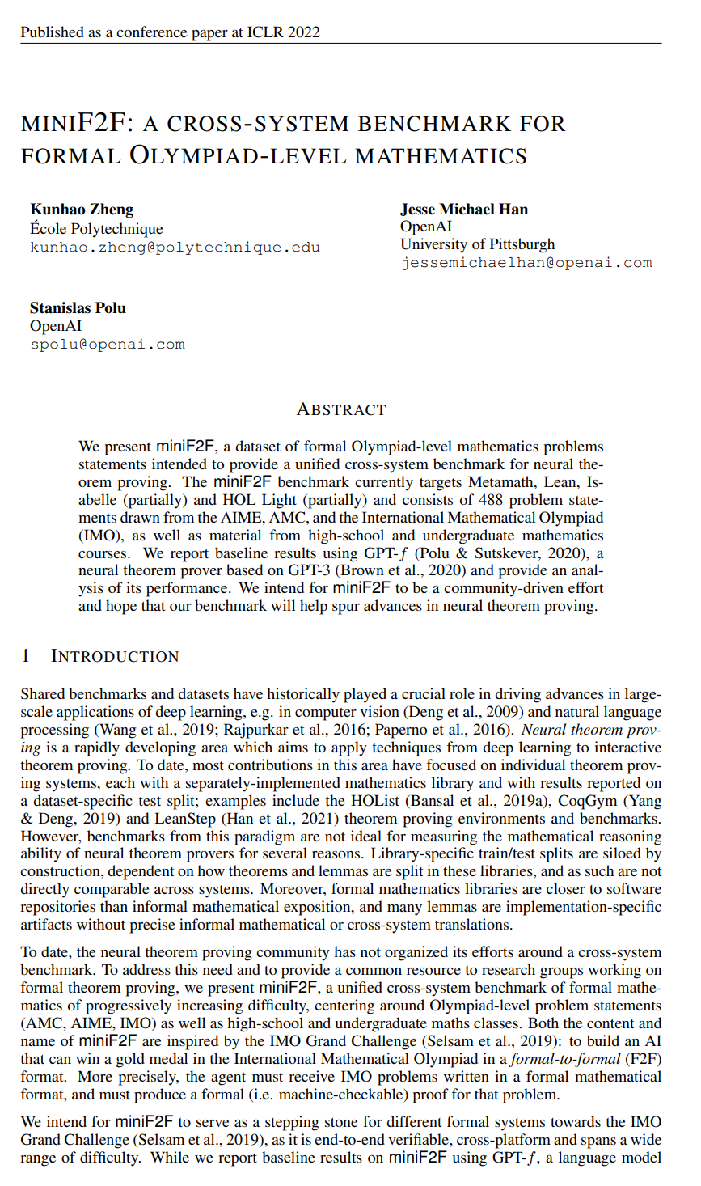
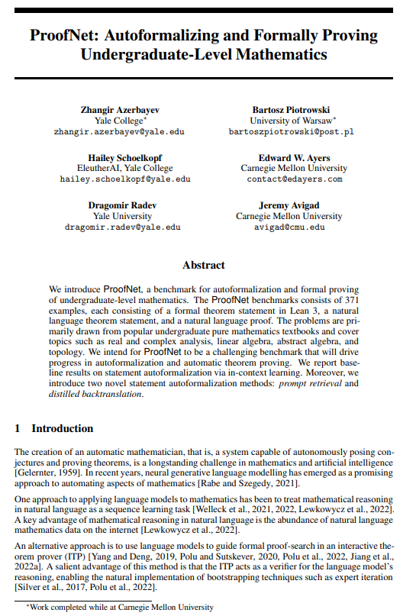
Related Work
Standard LLMs have severe limitations in autoformalization
Performance evaluated on benchmarks like miniF2F and ProofNet
Backtranslation used for data augmentation in NMT
Notes:
[Jakob]
The prior work related to our project centers around three main takeaways.
The first is that standard LLMs have severe limitations in autoformalization and lack the complex reasoning required to do mathematical tasks such as autoformalization and theorem proving.
Also, multiple reliable benchmarks have recently emerged for evaluating LLMs performance. In particular, ProofNet deals specifically with autoformalization, the task of translating between informal and formal math.
Finally, there is research on the method of backtranslation for data augmentation, which has been used to train state-of-the-art models in NMT. This is a core method we used, and we'll explain more in a bit.

Slide 4
The Big Idea
Consider proofs line-by-line.
Introduce AI4M: labeled training dataset of natural-language and Lean proofs.
Show results of this new approach.
Notes:
[Willy]
What’s your big idea? Flip the bit.
So what’s the big idea and bit flip here?
Well, we present our experiments for a new approach to teaching LLMs to reason mathematically by fine-tuning for autoformalization. This strategy considers tactic scripts line-by-line, which in theory allows for a more granular learning process. We also introduce AI4M, a labeled dataset of natural language proof statements and their equivalent formal language (Lean code) pairs. And furthermore, we also present results from training models on our datasets, showing the effectiveness of our method for autoformalization as well as its promise for automated theorem proving in the future.

Slide 5
Significance
Enhance accuracy in translating natural language math to formal, programmable mathematics (Lean code)
Implications for theorem proving, formal verification, etc.
Future vision: codify and expand human mathematical knowledge using AI models
Notes:
[Jakob]
The implications of success in this research are far-reaching. If we train an agent for accurate autoformalization, we massively reduce the time and cost required to formalize the world's huge collection of natural-language math.
This would make automated theorem proving far more accessible and effective while also advancing other fields of research such as formal verification and program synthesis.
In the long run, a good autoformalizer could make all of the world's mathematical knowledge, most of which is only written in natural language, programmable and accessible to systems like interactive theorem provers. An LLM capable of translating from natural language to formal code can make these systems more human usable, helping us to advance human mathematical knowledge in a significant way.

Slide 6
Informal-Formal Pairs
Informal
If $r$ is rational $(r \neq 0)$ and $x$ is irrational, prove that $r+x$ is irrational.
Formal
theorem exercise_1_1a (x : ℝ) (y : ℚ) : ( irrational x ) -> irrational ( x + y ) :=
Notes:
[Michael]
Here is an example of the data that we are trying to generate. On the left is a theorem written in natural language using LaTeX, and on the right is that theorem expressed as a Lean4 statement. We have massive amounts of math data written in natural language, but this is not machine readable like the formal language.

Slide 7
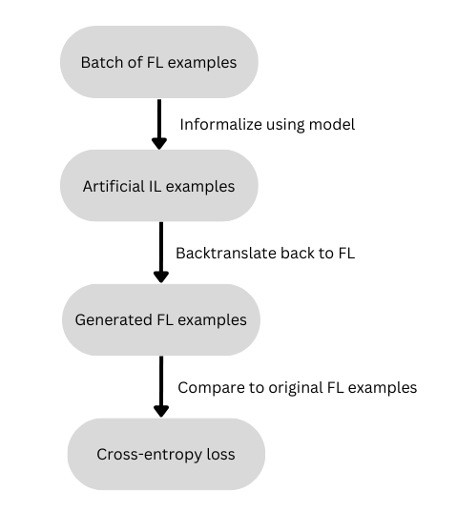
Backtranslation
Challenge: almost zero matching data of formal and informal mathematics
Solution: given FL dataset, generate artificial IL translations, then use (IL, FL) pairs for training
Limitation: our small model meant that artificial IL examples had limited usefulness
Notes:
[Jakob]
Now we'll talk about our methods.
The challenge of autoformalization is lack of data. For example, one of the largest formal math libraries is only 180MB in size, less than 0.18% of the training data for the LLM Codex. Also, there is almost zero aligned data, or matching pairs of natural language and formal mathematics.
We tried to solve this with backtranslation. During training, we use the model to translate from formal to informal, generating a matching pair. Then we have the model translate back to formal language. This avoids the problem of lack of paired data by having the model generate training data on the fly to teach itself.
The problem with this method was that our baseline model was small and not especially good at informalizing. While we got good results up to a point, the performance gain due to the training data that was generated during on-the-fly backtranslation eventually plateaued.
The next method we explored was using two models: one powerful "teacher" model to generate training data and a smaller "student" model to fine-tune on it.

Slide 8
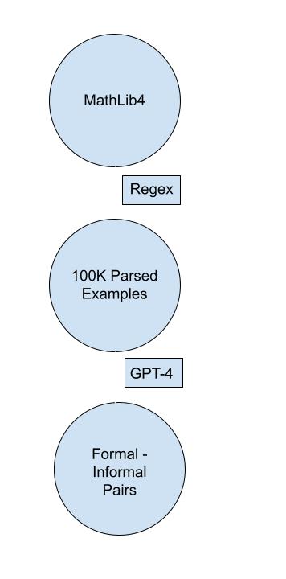
Offline Backtranslation
Mined MathLib 4 using Regex
Not a perfect solution because Lean is not a regular language
Use large neural model (GPT-4) as teacher model to pregenerate pairs, then fine-tune on a small model (GPT-2)
Limitation: Cost
{"formal": "theorem vsub_eq_sub {G : Type*} [AddGroup G] (g\u2081 g\u2082 : G) : g\u2081 -\u1d65 g\u2082 = g\u2081 - g\u2082 :=\n rfl\n #align vsub_eq_sub vsub_eq_sub\n \n section General\n \n variable {G : Type*} {P : Type*} [AddGroup G] [T : AddTorsor G P]",
"informal": "In an additive group $G$, the subtraction of vectors $g\u2081$ and $g\u2082$ is equal to the subtraction of the group elements $g\u2081$ and $g\u2082$."}
Notes:
[Michael]
We then used distilled backtranslation, where we pregenerate the informal-formal pairs using a powerful neural model, which in our case was GPT-4.
We first mined MathLib4, a large lean dataset, then used a Regex to roughly parse these lean files into over 100k tactic proof scripts, which we will call the “full-proof”
This has been explored before with MMA, the largest autoformalization dataset that used a 0-shot prompt on GPT-4
Instead, we used a 6-shot prompt to informalize the theorem statements with the entire proof as context and generated pairs between the formal theorem statement and the informal version of that theorem statement
Biggest limitation with this method was cost at about 5 cents per informalization

Slide 9
LeanDojo
(stateBefore, tactic, stateAfter)
stateBefore - what we know about the proof right not
tactic - what we are now trying to simplify the problem
stateAfter - what changed about what we know now
{
"formal": "by_cases ha : a \u2208 s",
"informal": "The proof divides into cases based on whether a is in set s or not."
}
Notes:
[Michael]
We also used GPT-4 to translate individual tactics from the LeanDojo dataset.
This consisted of concatenating these tuples of the state of the proof before a tactic is applied, or what we know about the proof right now, the tactic or method that is being applied (such as induction, contradiction, etc), and the state of the proof after that tactic is applied.
Here, you can see what the actual informalization looks like for a single tactic where the proof considers the different cases of an element being in a set or not.

Slide 10
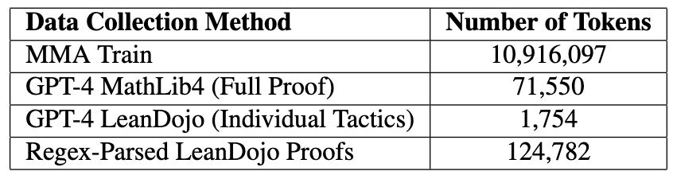
Methods
Other dataset generation methodologies:
MMA Train: (Baseline Dataset)
GPT-4 MathLib4
Backtranslation
GPT-4 LeanDojo (Indiv. Tactics)
Regex-Parsed
"formal": "intro h T0 hT0",
"informal": "We introduce new variables h."
Notes:
[Willy]
So this is a higher overview of all the methods we used to get more data for comparison purposes.
So to be totally clear in what each of these datasets are: MMA train is the baseline dataset we’re comparing against
GPT-4 MathLib 4 was the dataset Michael described previously, basically few-shot prompting on MathLib Data, and on the tactic script.
Jakob also talked about how we used on-the-fly backtranslation, where the model is generating data on the fly to teach itself.
For GPT-4 LeanDojo (Individual Tactics), we’re using intermediate information on the proof state and seeing how the proof state transitions as the tactics are applied, and Michael gave an example of what that looks like in the previous slide.
For Regex-Parsed LeanDojo Proofs, this consisted of parsing individual proof tactics from LeanDojo by using regular expressions, which basically consists of looking for consistent indicators of a proof methodology, and then automatically turning that into a natural language statement using set rules. For example, if a proof tactic uses the keyword “intro” or “induction” or “contradiction”, we know that it’s introducing a new variable or hypothesis into the proof environment or context or doing induction or establishing a contrdiction. Again, the intention here is to see if these smaller line by line translations can help the model learn, but it should be noted, that this use of a Regex can be inherently limiting in the complexity that is present in our proofs. And you can see an example of what that looks like here.

Slide 11
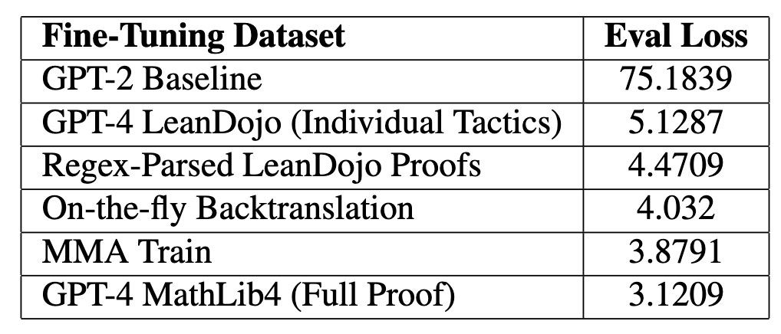
Results (Left Column is Data we trained on. Eval Loss on ProofNet Test Set)
Notes:
[Jakob]
For all of these datasets, we used GPT-2 as our base model when fine-tuning. We evaluated on the ProofNet test set which is the current benchmark used by our related works.
We saw that our on-the-fly backtranslation method considerably outperformed our baselines, but its performance plateaued below that of the MMA dataset. We think this is due to model size; both best-performing methods used GPT-4 to generate data for backtranslation.
[Michael]
We saw that GPT-4 parsing and informalizing proofs line by line performed significantly worse compared to informalizing on the whole proof.
We did see the GPT-4 informalized whole proofs with our prompt outperformed the MMA dataset, despite MMA being 150x larger.
We believe this performance difference is due to the added context we give the language model with the few-shot prompt, which creates more accurate informalizations. We only spent $15 to generate our dataset, compared to the $3,500 that MMA used for their dataset, meaning that in the context for this task, it’s better to spend more per informalization because the informalizations themselves are higher quality and you don’t need as much data.
[Willy]
We saw similar performance on the Regex-parsed LeanDojo dataset to the GPT-4 informalized dataset that considered the tactic scripts line by line, which suggests that neural models can’t translate the individual tactics in these proofs without the context of the proof as a whole.

Slide 12
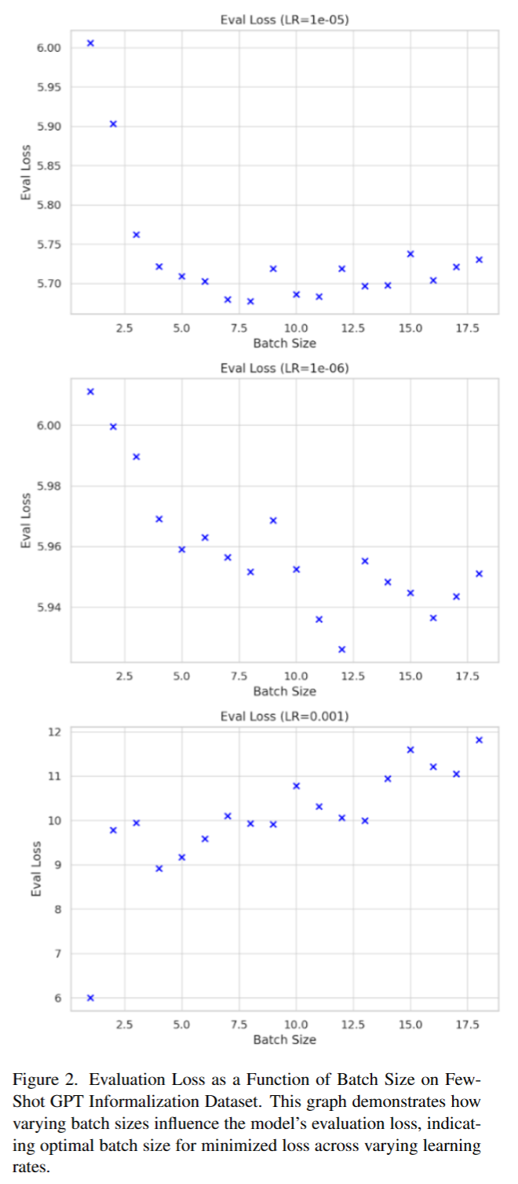
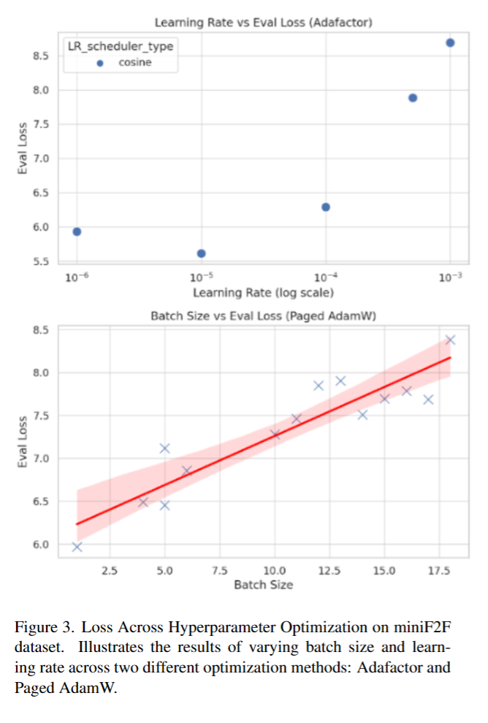
Results
Notes:
[Willy]
As an added result, we developed a pipeline to test our model performance using different hyperparameters, specifically for the learning rate and batch size.
Again, the most important feature of training this kind of model is still the underlying data, but by tuning these parameters we’re also able to achieve a higher performance. In general, lower batch sizes and a learning rate of 10^(-5) generally achieved the lowest possible eval loss on the ProofNet Benchmark, but the larger point is that we can further optimize the performance of these models with additional tuning.

Slide 13
Conclusion
GPT-4 better at informalizing whole proofs than line-by-line
Our AI4M dataset outperforms MMA when used to train GPT-2 despite being a much smaller dataset
Future work: use methods on larger models (e.g. Llemma-7B)
Check out our models + datasets: https://huggingface.co/AI4M
Notes:
[Jakob]
To conclude, offline backtranslation with GPT-4 as the teacher model generated promising results but was better on entire proofs than line-by-line.
Overall our Ai4m dataset outperformed the existing autoformalization dataset MMA despite being less than one hundredth of the size.
In our results we can clearly see the tradeoff between model size and cost to run, as well as the powerful effect of few-shot learning.
In the future, we would like to see our methods used to train larger models such as Llemma or Code-Llama, which are both more capable than GPT-2 and pretrained for reasoning tasks.
Finally, feel free to check out our models and datasets on HuggingFace. Thank you so much.

Slide 14
Thank you!

